Slide 1

Chapter 9 Part I
Maintainability
9.1 Analysis of Downtime
9.2 The Repair-Time Distribution
9.3 Stochastic Point Processes
Chapter 9
Notes:
If a failed component can be restored to an operating condition, then the analysis of its downtime is of interest. The time to restore or repair a failed component is a measure of its maintainability. Systems, components, and products may be restored to “as good as” condition, may experience “minimal repair,” or something in between.

Slide 2
9.1 Analysis of Downtime
total downtime
supply
delay
access
diagnosis
verify
& align
replace or repair
maintenance
delay
repair time
Chapter 9
Notes:
Reparable components are those that can be restored rather than replaced. Once a failure of a reparable component occurs, then the total downtime of the component consists of the activities shown. Usually the time spent waiting for repair resources (maintenance delay) and replacement parts (supply delay) are not considered part of the inherent repair time of the component. These times are determined based upon the level of maintenance support and the breadth and depth of the parts supply which are external to the component and its design.

Slide 3
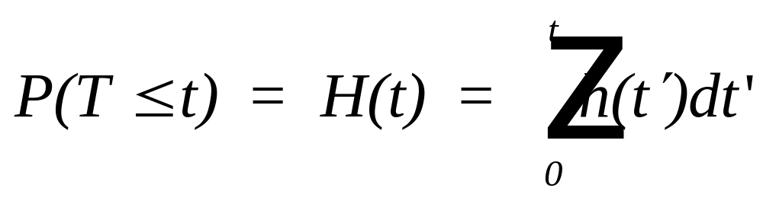

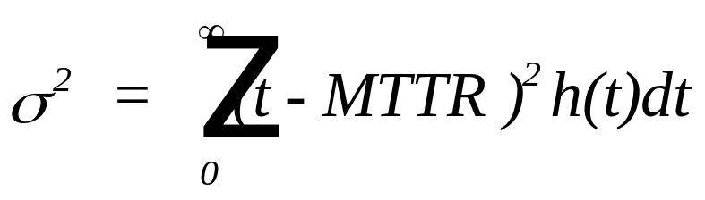
9.2 The Repair-Time Distribution
Let T = a continuous random variable, the time to repair
a failed unit where h(t) is the probability density
function (PDF). Then the CDF is
Chapter 9
Notes:
Maintainability is measured by the repair distribution that provides the probability that a repair will be completed in some time t. The Mean Time to Repair (MTTR) is the mean of that distribution.

Slide 4
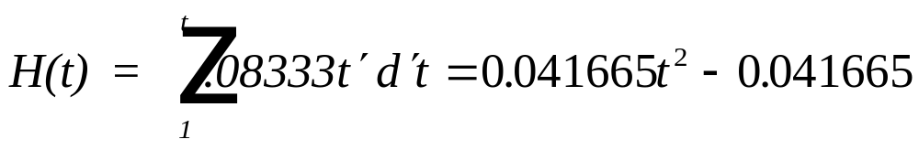
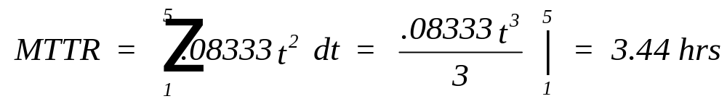
Example 9.2
Given h(t) = 0.0833 t 1 <= t <= 5 hr, then
Pr{T<3} = H(3) = .041665 x 9 - .041665 = .333
Chapter 9
Notes:
Given a repair distribution such as the one defined by the PDF, h(t), then repair probabilities, the mean, and other characteristics of the distribution can be found.

Slide 5
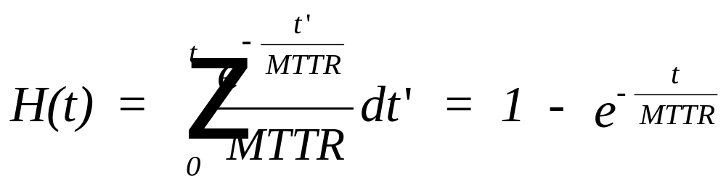
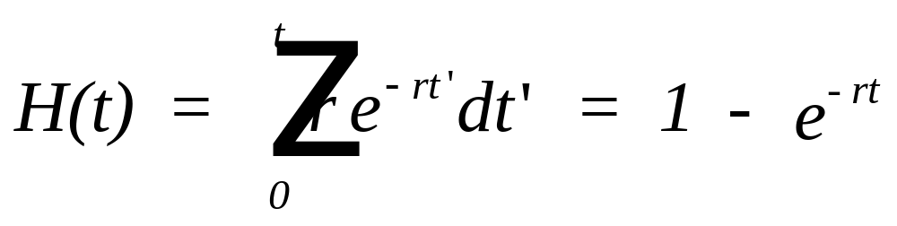
Exponential repair Times
Let r = 1/MTTR, the constant rate of repair, then
Chapter 9
Notes:
Exponential repair times have a constant repair rate that is the reciprocal of the MTTR. The repair rate is the instantaneous conditional rate of repair. That is, it is the probability of repair per unit time at time t given it has not been repaired as yet. The MTTR or the repair rate is the parameter of the distribution.

Slide 6
Exponential repair Times
A component can be repaired at the constant rate of 10 per 8 hour day. What is the probability of a single repair exceeding one hour?
Solution: The MTTR = .1 day = .8 hour.
Therefore P{T>1} = 1 - H(1) = e^{-1/.8} = e^{-1.25} = 0.2865
Chapter 9
Notes:
You should be able to use the exponential distribution as a repair distribution as well as a failure distribution.

Slide 7
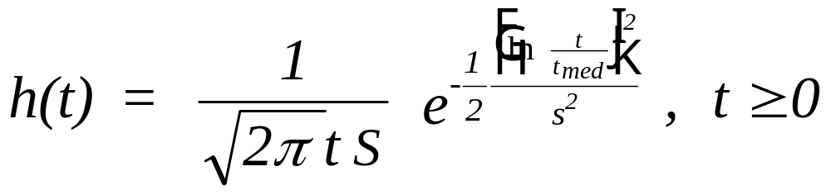
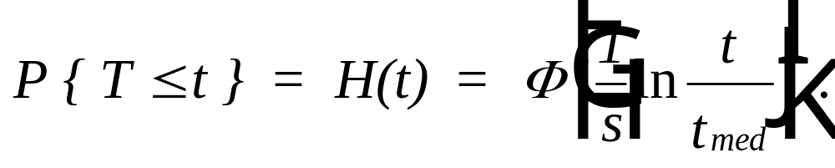
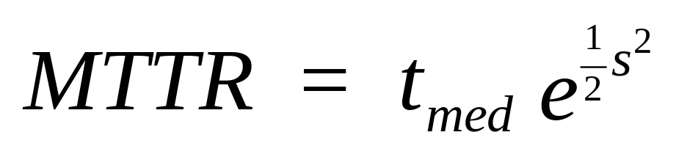
Lognormal Repair Times
Chapter 9
Notes:
Lognormal repair times are often observed in practice. Analyzing lognormal repair times makes use of the underlying normal distribution in the same manner as in analyzing lognormal failure times.

Slide 8
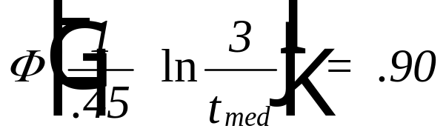
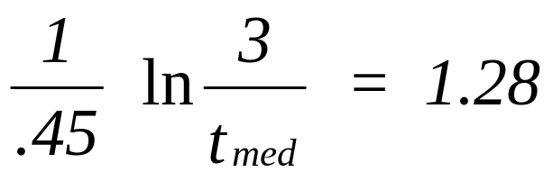
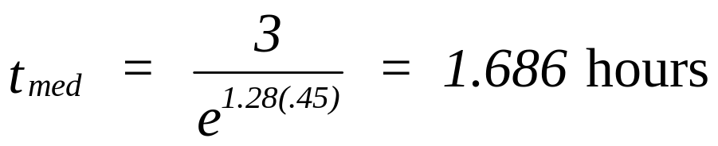
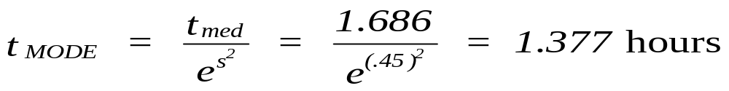
Lognormal Repair Times
A requirement exists for an engine fuel pump to be repaired
(or replaced) within three hours ninety percent of the time.
If the repair distribution is lognormal with s = .45, what MTTR
should be achieved to meet this goal?
Chapter 9
Notes:
You should be able to use the lognormal distribution as a repair distribution as well as a failure distribution. What can be said about the lognormal repair rate?

Slide 9
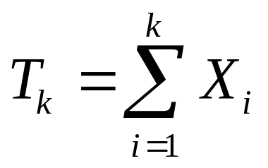
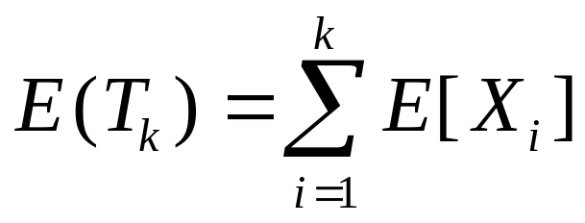
9.3 Stochastic Point Processes
A stochastic point process is characterized by isolated events occurring
at instants distributed randomly over a time continuum. The events in
this case are failures with T₁ , T₂ , ... , representing their occurrence times.
T_{k} = a random variable, the (operating) time to the k^{th} failure where
T₀ = 0, and X_{k}= T_{k} - T_{k-1} = a random variable, the (operating) time*
between the (k-1)^{st} and k^{th} failure.
E[X_{i}] is the Mean Time Between Failures (MTBF)
*or clock time assuming repair time is negligible
Chapter 9
Notes:
When observing reparable components, a failure, repair, failure, repair, …. cycle is introduced. There is no longer a single time to failure but rather multiple times between failures. Therefore, interest turns to the distribution of the time to the next (i^{th}) failure (X_{i}) and the mean time between failures. Failures at discrete but random points in time generate what is called a stochastic point process.
In this discussion concerning stochastic point processes, it is assumed that the repair time relative to the time to failure is negligible and can be ignored or the time between failures is measured in operating time.

Slide 10
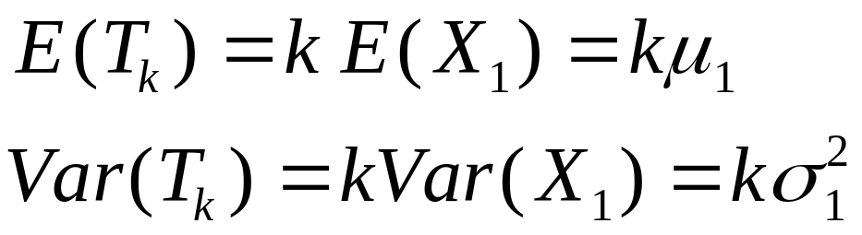
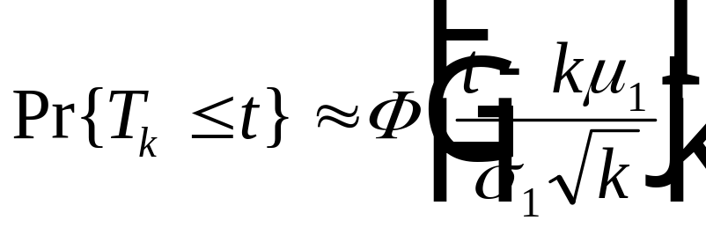
Renewal Process
A renewal process is defined to be one in which the random
variables, X_{i} , are independent and identically distributed (IID).
i.e. repair to “as good as new”
From the CLT:
Chapter 9
Notes:
A special and important type of a stochastic point process is a renewal process. Renewal processes occur when the distribution of the time between failures does not change. That is the distribution of X_{i} (time between the i-1 and the i^{th} failure) is the same as the distribution of X_{j} (time between the j-1 and the j^{th} failure). This concept is consistent with the notion of “repairing to as good as new” since following each repair, the time to the next failure is the same as the time to the first failure. Based upon the central limit theorem, if a large number of these random variables are added together, their sum is approximately normally distribution with the mean and variance as shown.

Slide 11
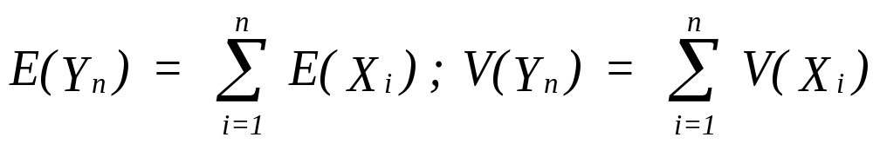
Central Limit Theorem
If Y_{n} = X₁ + X₂ + …+ X_{n} where the X_{i} are
independent random variables with means
E(X_{i}) and variances, V(X_{i}), then
Y_{n} has an approximate normal distribution with
Chapter 9

Slide 12
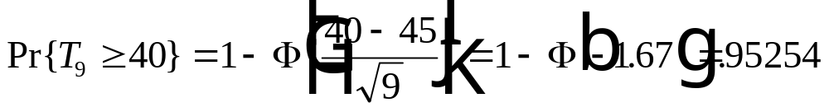
Example 9.5
A cutting tool has a time-to-failure distribution which is normal =with a mean of 5 operating hr. and std dev = 1 hr. Nine replacement tools are available with which to complete a 40 hr. production run. Find R(40) given the 9 cutting tools.
Chapter 9
Notes:
This example makes use of the normal distribution as an approximation under the central limit theorem to the sum of 9 lognormal random variables. This is a renewal process since the part is replaced (read “restored to as good as new”) upon failure.

Slide 13
Number of Failures
Letting N(t) be a discrete random variable, the cumulative
number of failures in the interval (0,t), then N(t) ≥ 0 and a
nondecreasing function of time. Further
Pr{N(t) = 0} = Pr{T₁ > t}
Pr{N(t) = j} = Pr { T_{j} <= t < T_{j+1} } = Pr { T_{j+1} >=t } - Pr { T_{j} > t }
for j = 1, 2, ....
Chapter 9
Notes:
In addition to the continuous random variables, X_{i}, a stochastic point process will also generate a discrete random variable, the number of failures in time t. In analyzing these processes, interest may be in either or both probability distributions. In general, the probability of zero failures in time t is equal to the probability that the first failure occurs after time t. The probability of exactly j failures occurring in time t is equal to the probability that the j^{th} failure occurs by time t and the j+1st failure occurs after time t:
Pr { T_{j} <= t < T_{j+1} }.

Slide 14
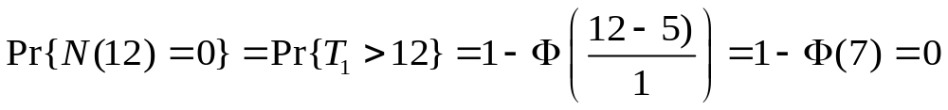
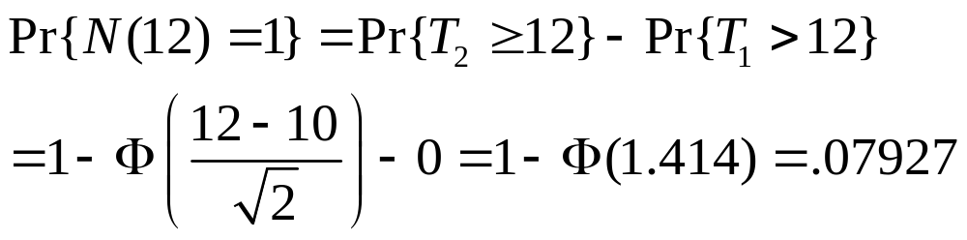
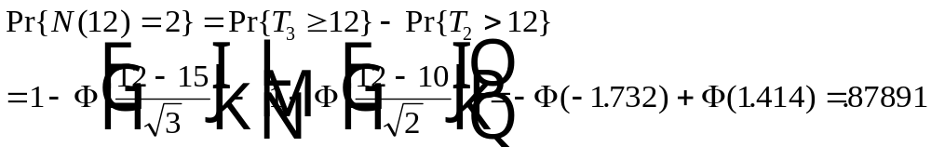
Example 9.5 (cont.)
Distribution of the number of failures in the first 12 hours:
Chapter 9
Notes:
Continuing with this example, the specific discrete probability distribution for N(12), the number of failures in 12 hours, is found using the normal approximation for T_{i}.

Slide 15
Example 9.5 (cont.)
Distribution of the number of failures in the first 12 hours:
Pr{N(12) = 3} = .04179
Pr{N(12) = 4} = .00003
Pr{N(12) >= 5} = 0
E{N(12)} = 0 + 1(.07927) + 2 (.87891) + 3 (.04179) + 4 (.00003) = 1.96.
Chapter 9
Notes:
Continuing with this example, the specific discrete probability distribution for N(12), the number of failures in 12 hours, is found using the normal approximation for T_{i}.

Slide 16
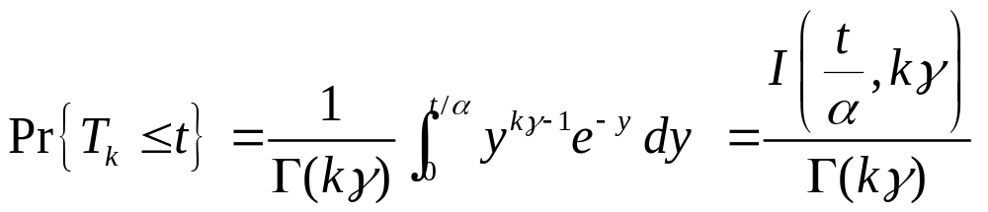
Gamma Failure Distribution
If X_{i} has a gamma distribution with shape parameter γ and scale parameter α, then from the additive property of the gamma distribution, T_{k} will also have a gamma distribution with shape parameter kγ and scale parameter α. Therefore
Chapter 9

Slide 17
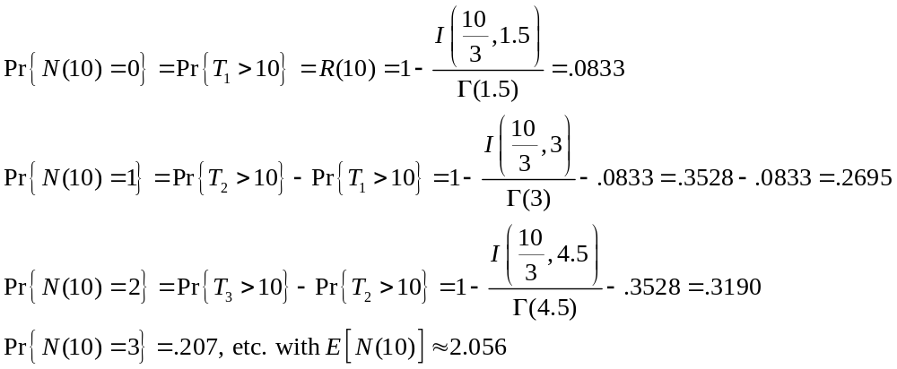
EXAMPLE 9.6
A 40-gal hot water heater having a gamma failure distribution with γ = 1.5 and α = 3 yr is replaced upon failure. For t = 10 yr,
E[T₂] = 9 yr. and E[T₃] = 13.5 yr.
Chapter 9

Slide 18
Stationary Process
For s < t, N(t) – N(s) = the number of events (failures) that occur in the interval (s,t].
If N(s+t) – N(s) has the same distribution as N(t) for all t > 0 and s ≥ 0, then N(t) forms a stationary process
The number of events that occur in any interval is dependent only on the length of the interval and not on its start time.
Chapter 9

Slide 19

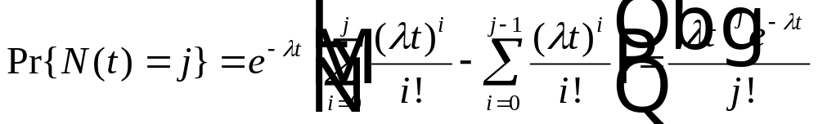
Homogeneous Poisson Process (HPP)
If X_{i} is exponential with parameter ; then T_{k} is gamma with
parameters k and ; and
That is N(t) has a Poisson distribution with E{ N(t) } = λt
Chapter 9
Notes:
A important example of a renewal process occurs when the time between failures is exponential. Then the time to k^{th} failure, T_{k}, will be gamma and the number of failures in time t, N(t), will be Poisson as discussed in Chapter 3.

Slide 20
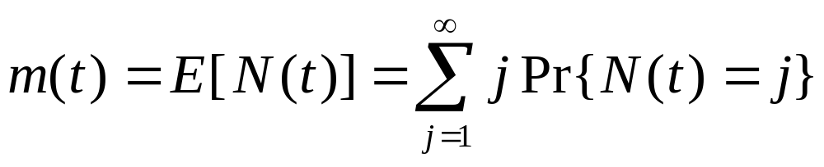
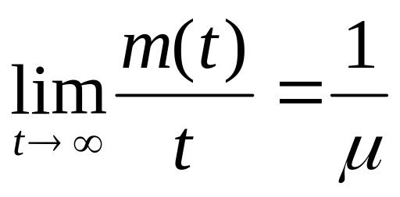
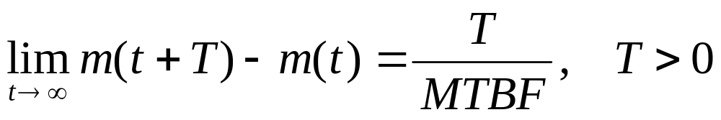
Renewal Function
Elementary Renewal Theorem:
μ = MTBF
Corollary:
Chapter 9
Notes:
For a renewal process, the function m(t) is called the renewal function. It is the expected number of failures in time t, the mean of the distribution of N(t). Using what is known as the Elementary Renewal Theorem, the long-run or steady-state average number of failures in time t is approximately equal to t / MTBF. A corollary is for any time period T, if the system is in steady-state, then the expected number of failures is T / MTBF.

Slide 21
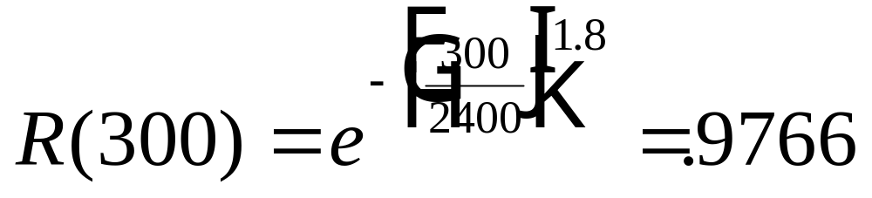
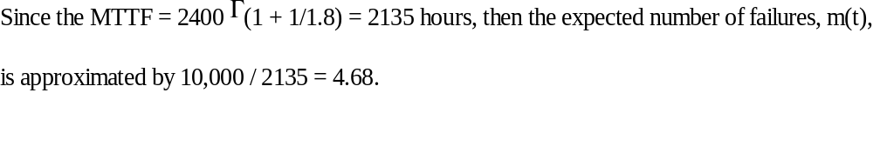
Example 9.6
A motor has a (first) time to failure distribution which is Weibull
with theta = 2400 hrs and a beta of 1.8 . Determine its reliability
at 500 hours if the motor has failed at 200 hours and is restored to as
“good as new” condition. How many failures are expected in the
first 10,000 hours of use?
Chapter 9
Notes:
An example of the use of the elementary renewal theorem.

Slide 22
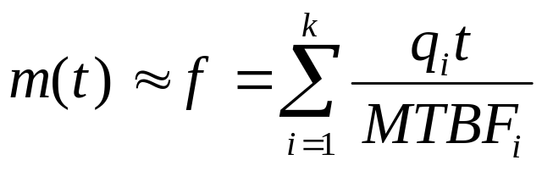
Superimposed Renewal Process
Machine 1
Machine 2
Machine 3
Machine 4
- machine failures
If each of k components are independent renewal processes,
then for sufficiently large t, the number of failures in the interval
(0,t) is
and MTBF_{s} = t / f
q_{i} = nbr identical type i components
Chapter 9
Notes:
If two or more independent renewal processes are observed, the union of their failure events will also form a stochastic point process. This is then referred to as a superimposed renewal process. What is significant about this process, is that it will form an approximate homogeneous Poisson process if there are a sufficient large number of independent processes in steady-state. Further, the MTBF of this superimposed process will be given by t / m(t).

Slide 23
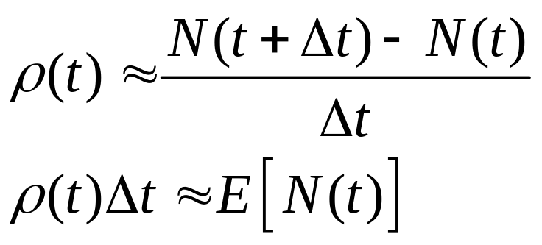
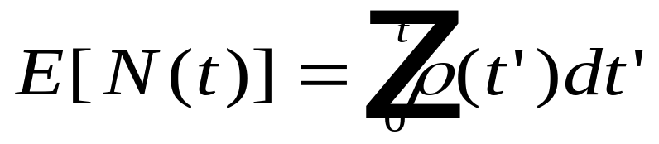
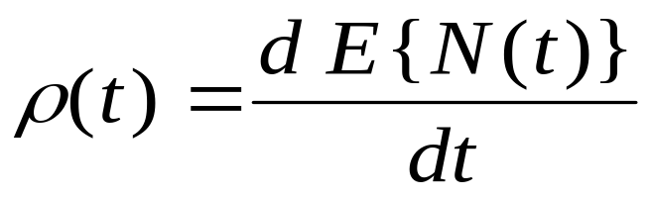
Minimal repair
Define Intensity function:
let ρ(t) = (unconditional) failure rate at time t
Chapter 9
Notes:
Not all stochastic point processes are renewal processes. Often repair consists of fixing or replacing a single part with the rest of the system unaffected by the repair process. Therefore, the remaining components continue to age and only a minimal repair has taken place. Therefore the distributions of the time between failures are not independent and identical. To model this situation, an intensity function is defined to be the rate of change of the expected number of failures in time t with respect to t. It is approximately equal to the expected number of failures in the interval from t to t + Δt divided by Δt. By integrating the intensity function from 0 to t, the expected number of failures in time t is obtained.

Slide 24
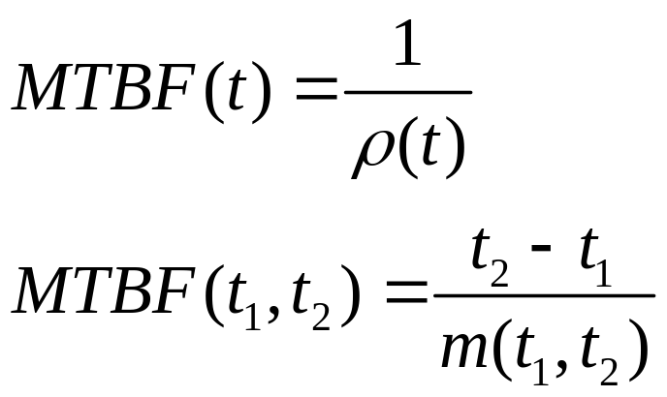
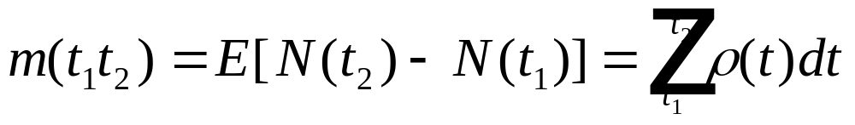
Minimal repair
where
Chapter 9
Notes:
Given the intensity function for a stochastic point process, the (instantaneous) MTBF and an interval MTBF(t₁,t₂) can be obtained.

Slide 25

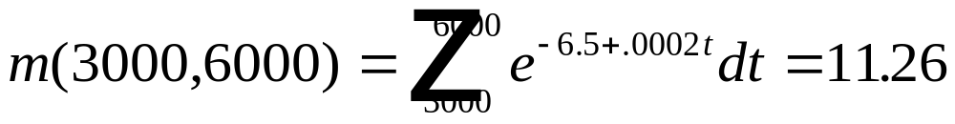
Example 9.8
A manufacturing machine has an intensity function given by
(t) = exp(-6.5+0.0002t) with t measured in operating hours.
After 1 year of operation (3000 hours), ρ(3000) = .0027394 and
the instantaneous MTBF = 1/ ρ(3000) = 1/.0027394 = 365 hours.
The expected number of failures over the second year is
Chapter 9
Notes:
Integrate the intensity function to find the expected number of failures.

Slide 26
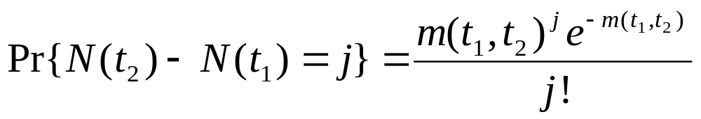
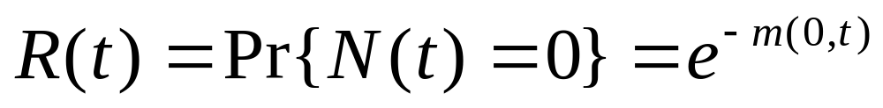
Nonhomogeneous Poisson Process (NHPP)
N(0) = 0
Chapter 9
Notes:
If the number of failures in a given time interval is Poisson distributed with a mean dependent upon the time interval, then this stochastic point process is called a nonhomogeneous Poisson process. It has the probability distribution shown where m(t₁,t₂) is its mean. Therefore the reliability at time t is equal to the probability of no failures at time t.

Slide 27
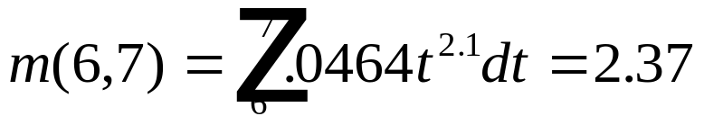
Power Law Process
(t) = a b t^{b-1} , a,b > 0
A six year old regional transit bus experiences minimal repair
upon failure. It was found to have an intensity function given by
(t) = .0464 t^{2.1} with t measured in years.
1. Then MTBF (instantaneous) = 1 / [(.0464) (6)^{2.1} ] = .5 years
2. The expected number of failures during the 7th year is:
Chapter 9
Notes:
If the intensity function is a power function (constant1 t ^ constant2), then the process is called a power law process (or sometimes a Weibull process because the functional form of the intensity function is the same as the Weibull hazard ate function).

Slide 28
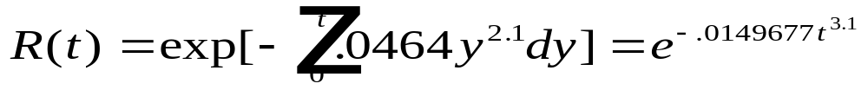


Power Law Process (continued)
3. Pr{exactly one failure in the 7th year} = Pr{ N(7) - N(6) = 1}
= 2.37 e^{-.2.37} = .222
4. The conditional reliability for the 7th year given it has survived
through the 6th year:
R(1|6) = Pr{N(7) - N(6) = 0} = e^{-2.37} = .093
5. The unconditional reliability:
Weibull with = 3.1 and = 3.878
Chapter 9
Notes:
Given an intensity function, you should be able to compute the failure probabilities and reliabilities associated with the stochastic point process.

Slide 29
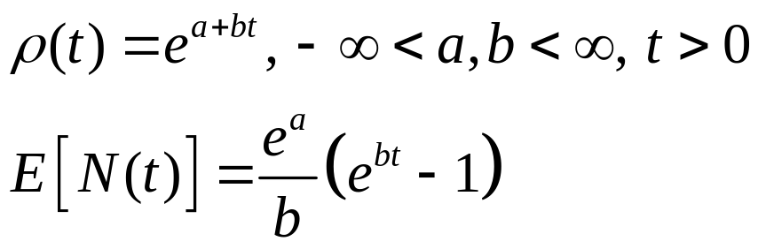
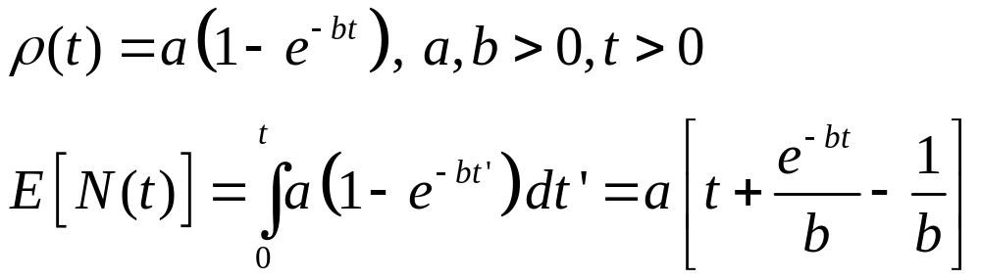
Other Intensity Functions
Log-linear:
Bounded:
Chapter 9

Slide 30
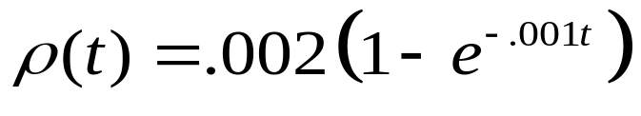
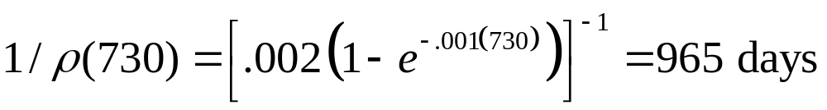
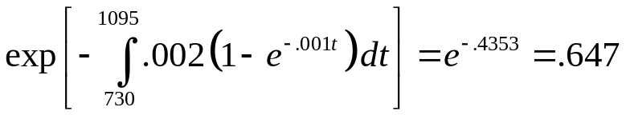
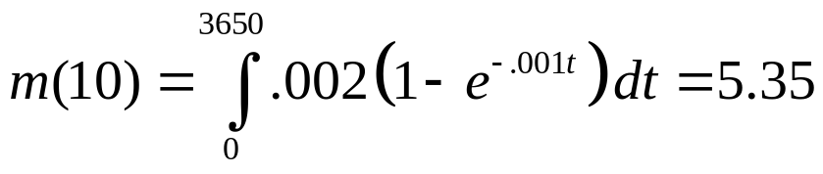
Example
A system under minimal repair has the intensity function
where t is measured in days. The system has been operating for 2 years (730 days). Its instantaneous MTBF is
and its reliability over the next year is
By the tenth year,
Chapter 9

Slide 31
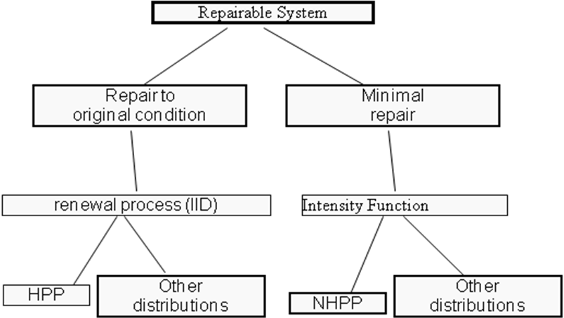

Stochastic Point Process
Chapter 9
Notes:
In summary, stochastic point processes can be a renewal process or a process generated by minimal repair. Homogeneous Poisson Processes (HPP) and non- Homogeneous Poisson Processes (NHHP) are two important cases.

Slide 32
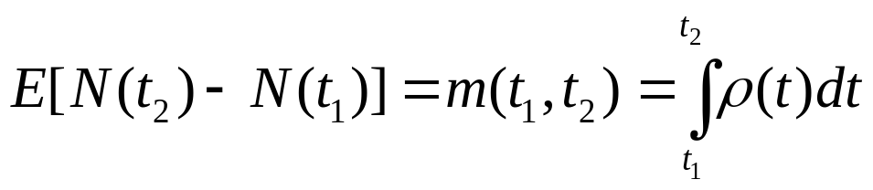
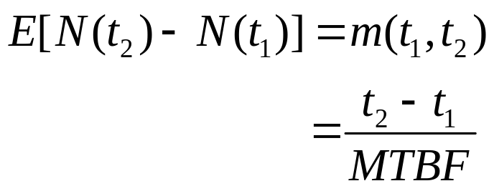






Renewal vs. Minimal repair
Repair to “as good as new” Minimal Repair
MTBF = MTTF MTBF = (t₂ – t₁) / m(t₁,t₂)
HPP (CFR): NHPP:
Power law process:
Chapter 9

Slide 33


Overhauls
T_{o} = a constant, the scheduled time between overhauls
T_{ov} = a random variable the time between overhauls where
overhauls occur at the scheduled time or at a failure time
Chapter 9
Notes:
Consider a renewal process in which there is also a scheduled repair (overhaul) that occurs at time T_{o}. If a failure occurs before time T₀, then an overall occurs at the time of the failure. What is of interest in this case, is the expected time between overhauls. This time is the sum of the time to a scheduled overhaul (T₀) times the probability of no failures before the scheduled time R(T₀), plus the partial expectation of the mean failure time between 0 and T (the average time to failure from 0 and T₀).

Slide 34

Overhaul with Exponential Failures
An aircraft engine is scheduled for a complete overhaul every
10,000 flying (operating) hours or upon a failure requiring
removal of the engine from the aircraft. Assuming a CFR of
10⁻⁵ failures per flying hour for engine removal failure modes,
E[T_{ov} ] = 10⁵ ( 1 - e^{-.1} ) = 9516 flying hours
Chapter 9
Notes:
An example to find the expected time to an overhaul.

Slide 35
Cycle Time
X_{i} = a random var, the time to the ith failure (following restoration)
S_{i} = a random var, the repair time* of the ith failure, then
Y_{i} = X_{i} + S_{i} is the length of time of the ith renewal cycle.
The time of the ith renewal, T_{i} , can then be found from
T_{i} = T_{i-1} + Y_{i} , i = 1, 2, .... with T₀ = 0.
*a renewal process
Chapter 9
Notes:
In the discussion concerning stochastic point processes, it was assumed that the repair time relative to the time to failure was negligible or the time between failures was measured in operating time. If we allow for the repair time to be a significant part of a renewal failure-repair cycle, then the sum of the failure and repair time random variables is a random variable of the cycle time.

Slide 36

Cycle Time
Y_{i} (cycle time) is a random variable with PDF g(t)
X_{i} (time to failure) has PDF f(x),
S_{i} (repair time) has PDF h(s) and X_{i} and S_{i} are independent, then
E(Y_{i}) = E(X_{i} + S_{i}) = E(X_{i}) + E(S_{i}) or MTBF = MTTF + MTTR,
Var(Y_{i}) =Var (X_{i} + S_{i}) = Var (X_{i}) + Var (S_{i}), and
Chapter 9
Notes:
The problem is determine the distribution of the cycle time given the failure and repair time distributions. The above integral is a convolution of the two distributions and assumes that the failure and repair random variables are independent.
The above integral may be solved in some cases using Laplace transforms. The transform of a convolution is equal to the product of the transforms of the two functions.

Slide 37


Exponential Failure and Repair Times
Assume CFR of λ and a constant repair rate, r:
Chapter 9
Notes:
If both the failure and repair distributions are exponential, then the integral may be solved directly as shown.

Slide 38

EXAMPLE 9.13.
The time between failures requiring depot level maintenance of an aircraft engine is exponential with a MTTF of 200 days. Depot repair time is exponential with a MTTR of 12 days. Therefore
The probability that the next failure and repair cycle will occur within 90 days is found from G(90) = .3217
Chapter 9

